Slide 1

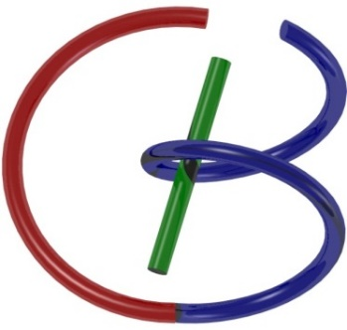
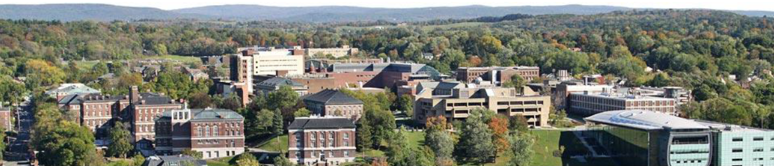
CT Physics
Ge Wang
AI-based X-ray Imaging System (AXIS) Lab
Rensselaer Polytechnic Institute, Troy, New York, USA
September 24, 2021
Notes:
Hello, since Professor Wang has a conference today out of town, I will give this hands-on introduction based on this PPT we prepared together. As he mentioned last time, we will have deep learning final projects by the end of the semester. Tentatively, we will have five lectures on deep learning hands-on, including this one.

Slide 2
MI Schedule for F21
Tue | Topic | Fri | Topic
08/31 | Introduction | 09/03 | Neuron, Network & Backpropagation
09/07 | No Class | 09/10 | Hands-on 1: Python, Colab, & TensorF
09/14 | Architectures & Training | 09/19 | Hands-on 2: MNIST Classification
09/21 | Image Quality I | 09/24 | CT Physics
09/28 | CT Reconstruction | 10/01 | Deep CT Reconstruction
10/05 | Hands-on 3: CT Networks | 10/08 | More CT Contents
10/12 | MRI Physics | 10/15 | Spin-Echo
10/19 | K-Space Theorem | 10/22 | More MRI Contents
10/26 | Mid Exam | 10/29 | Deep MRI Reconstruction
11/02 | Hands-on 4: MRI Networks | 11/05 | Nuclear Physics
11/09 | Nuclear Imaging | 11/12 | US Imaging
11/16 | Optical Imaging | 11/19 | Multimodality Imaging
11/23 | Hands-on 5: Image Conversion | 11/26 | Thanksgiving
11/30 | Image Quality II | 12/03 | Stability, Interpretability, & Others
12/07 | Overview | 12/10 | Final Exam
Office Hour: Teaching Day 5-6pm: https://rensselaer.webex.com/meet/wangg6

Slide 3
Outline
X-ray Nature
Wave
Particle
X-ray Attenuation
Mechanisms
Beer’s Law
X-ray Tubes/Sources & Detectors
Sources & Detectors
Breast Imaging Examples
Radiation Dose
Dosimetry
Low-dose CT

Slide 4
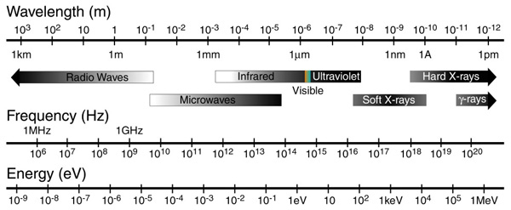
X-ray Waves
0.01-10nm
https://nau.edu/cefns/labs/electron-microprobe/glg-510-class-notes/signals/%23Absorption_of_electromagnetic_radiation

Slide 5
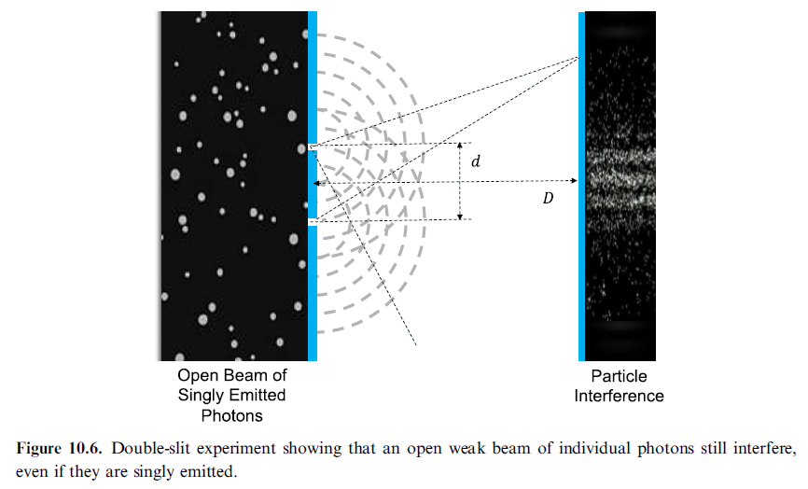
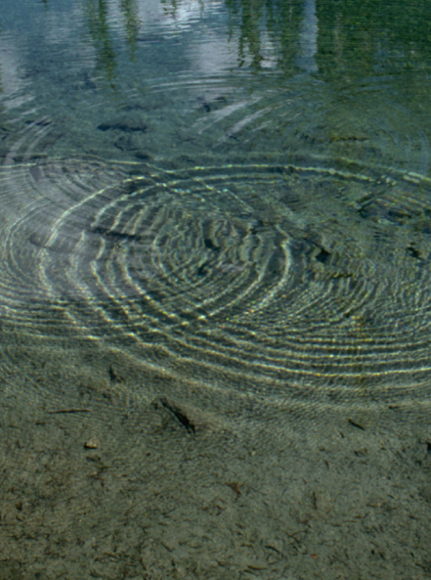
X-ray Interference

Slide 6
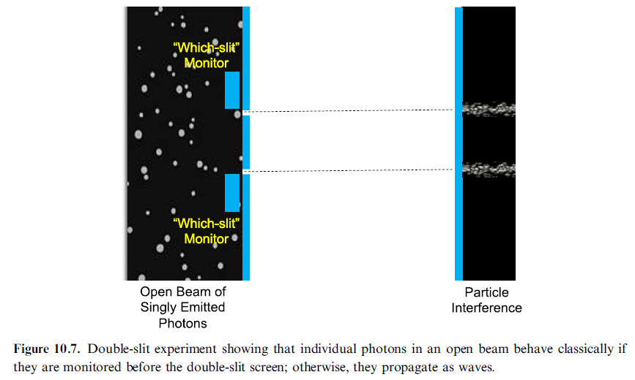
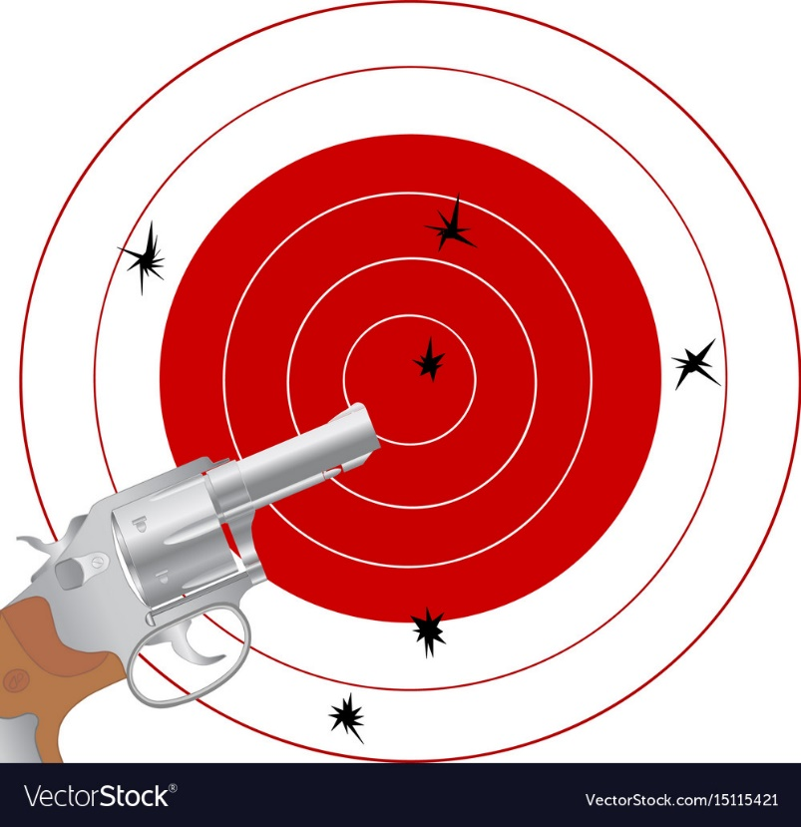
X-ray Photons

Slide 7
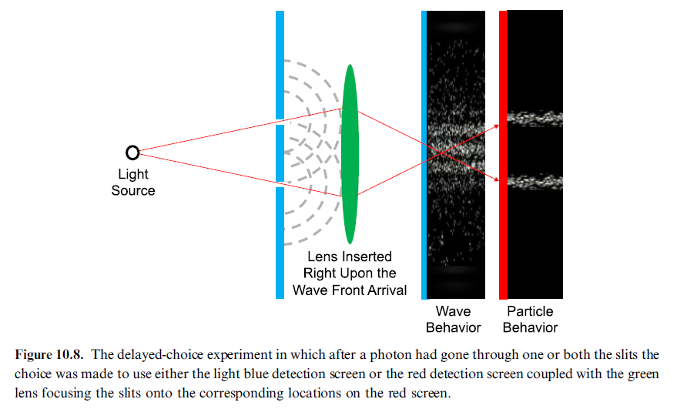
Double Slit Experiments

Slide 8
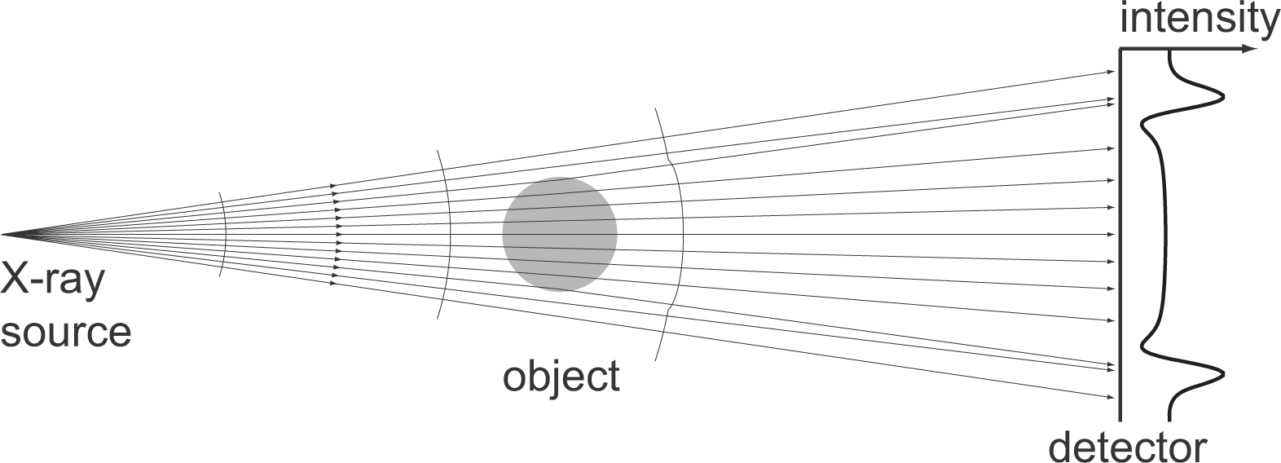
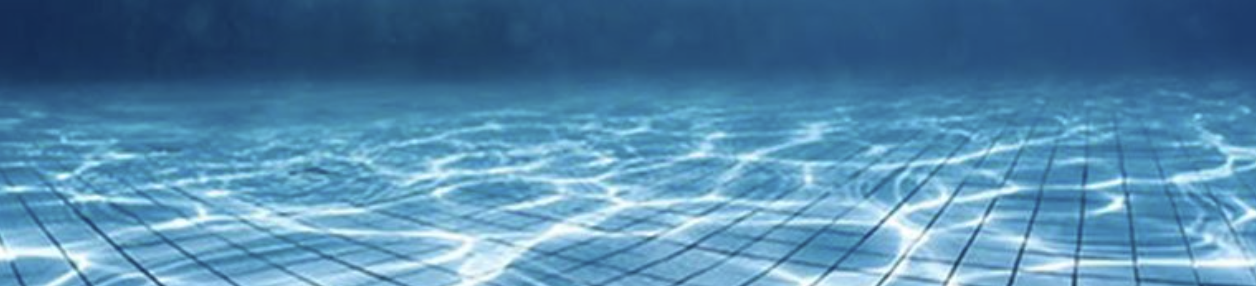
Wave Propagation: In-line Phase-contrast Imaging
https://www.osapublishing.org/oe/fulltext.cfm?uri=oe-19-11-10359&id=213838

Slide 9
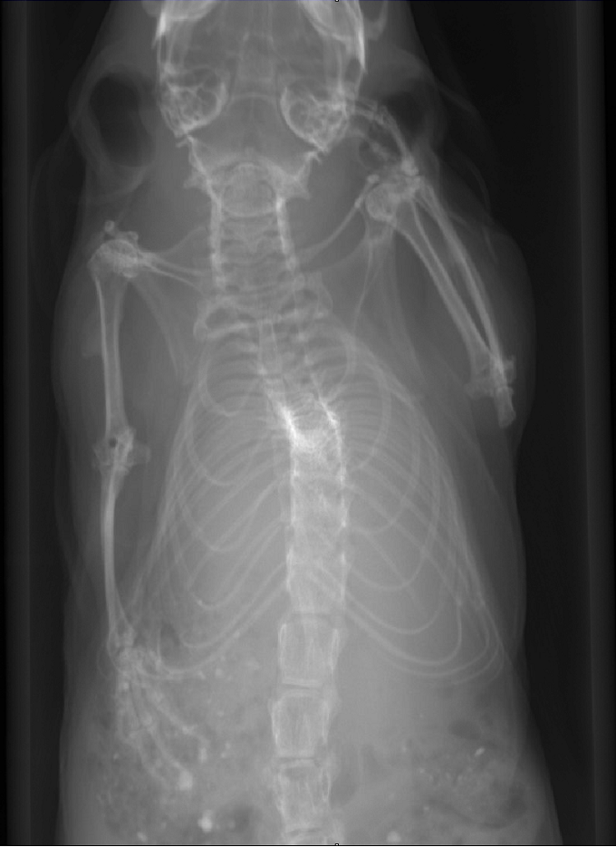
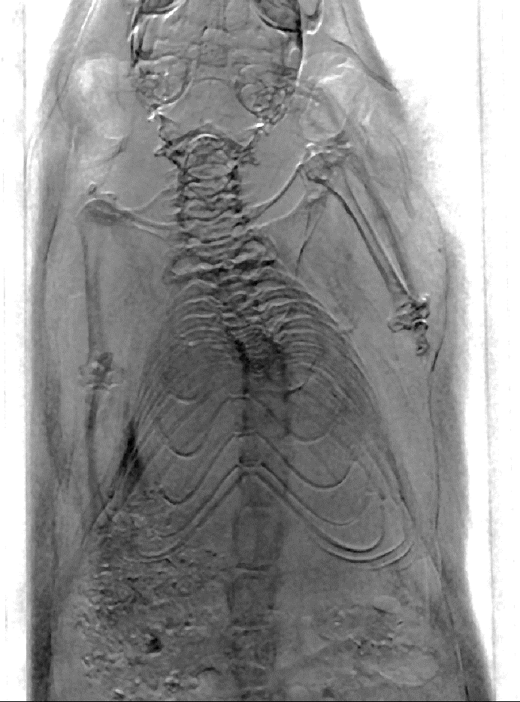
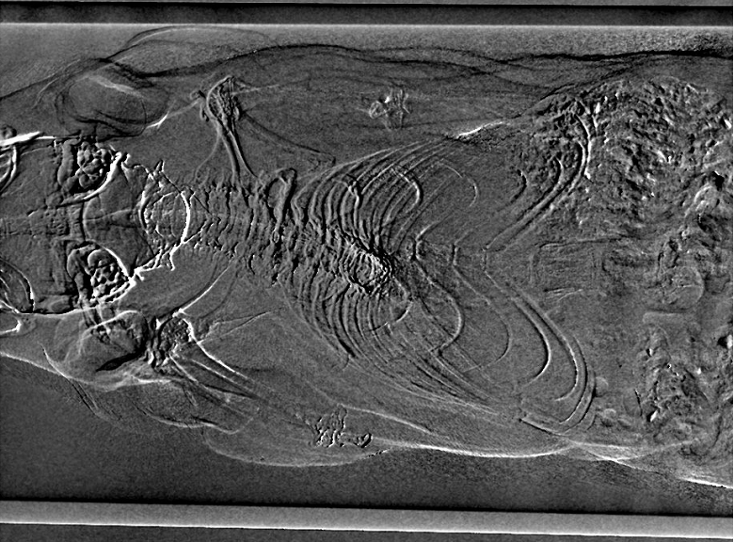
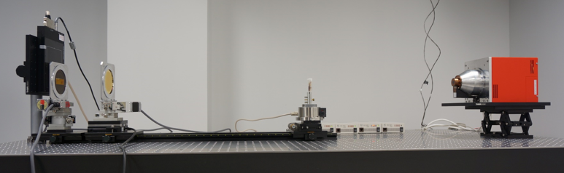
X-ray Grating Interferometric Results
Attenuation
Phase-contrast
Dark-field
Trachea Invisible in Attenuation
Cartilage
Texture of Muscle
Hair Invisible in Attenuation

Slide 10
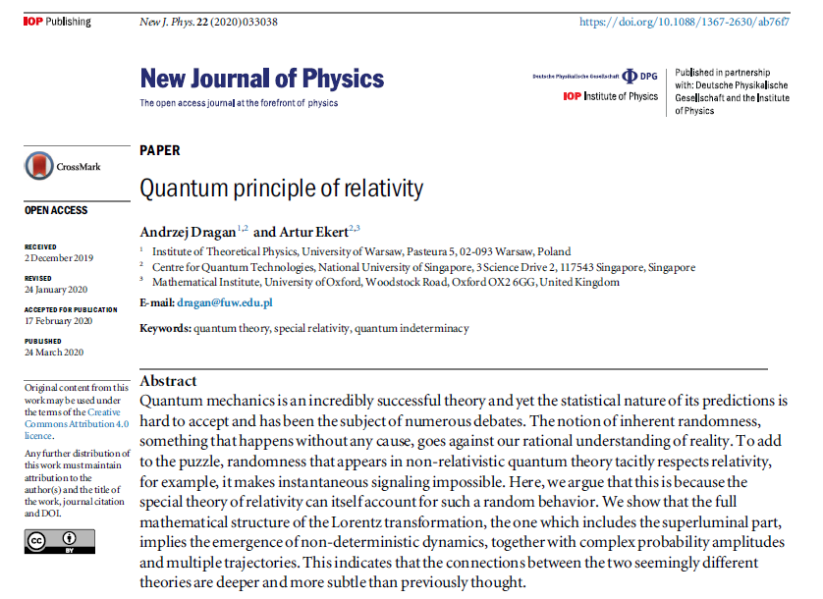
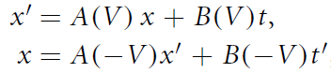
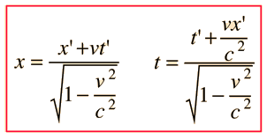
Quantum Principle of Relativity
The 1st postulate (Relativity)
The physical laws are the same in all inertial frames.
The 2nd postulate (Speed of Light)

Slide 11
Outline
X-ray Nature
Wave
Particle
X-ray Attenuation
Mechanisms
Beer’s Law
X-ray Tubes/Sources & Detectors
Sources & Detectors
Breast Imaging Examples
Radiation Dose
Dosimetry
Low-dose CT

Slide 12
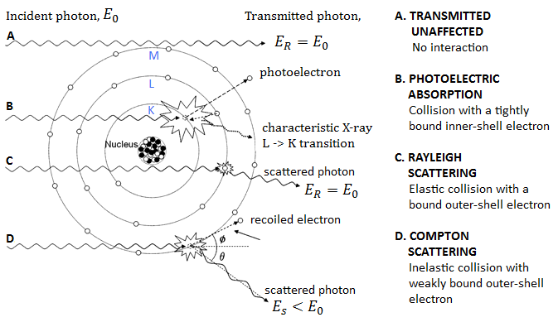
X-ray Interactions with Matter
Types of Interaction between an X-ray photon and the atom of irradiated matter for x-ray beam energy 15-150keV (adapted from Seibert J.A and Boone J.M., 2005)

Slide 13
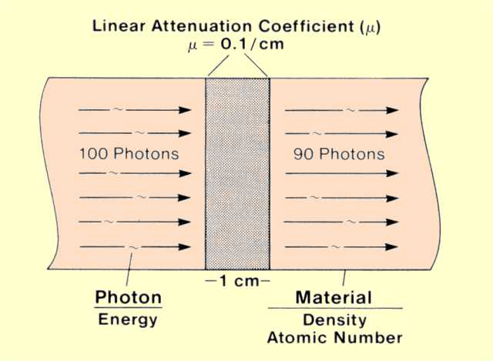
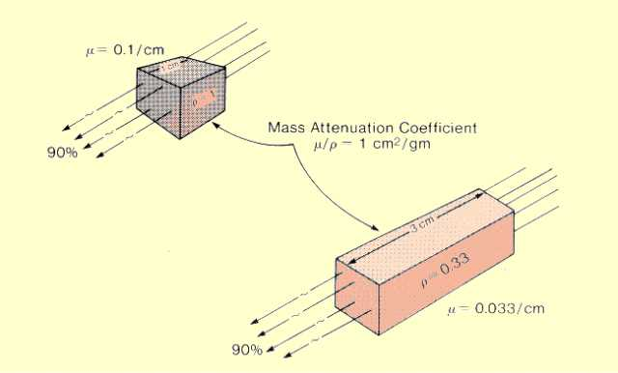
Linear & Mass Attenuation
The Same Amount of Material
http://www.sprawls.org/ppmi2/INTERACT/

Slide 14
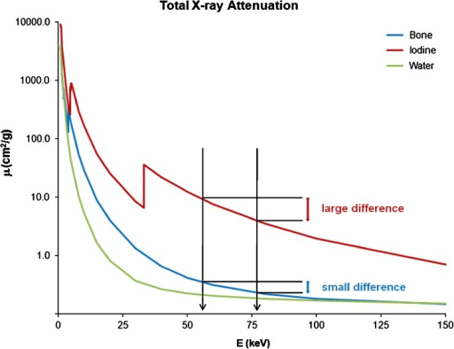
X-ray Attenuation Curves
It Depends on Both Material and Energy!
https://openi.nlm.nih.gov/detailedresult.php?img=PMC3259372_13244_2010_57_Fig1_HTML&req=4

Slide 15
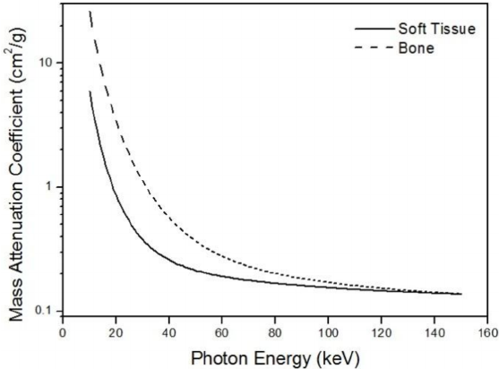
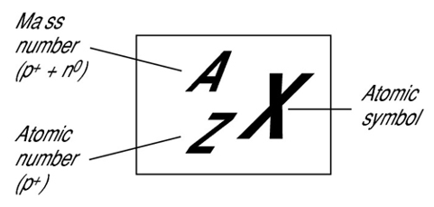
Two Basis Functions
Material
Energy

Slide 16
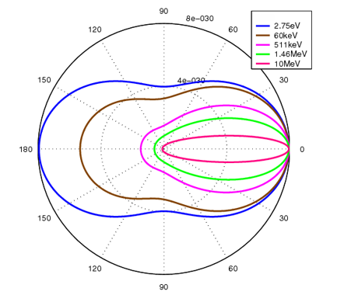
Klein–Nishina Function
Klein–Nishina distributions of scattering over a range of x-ray energies
https://en.wikipedia.org/wiki/Klein%E2%80%93Nishina_formula

Slide 17
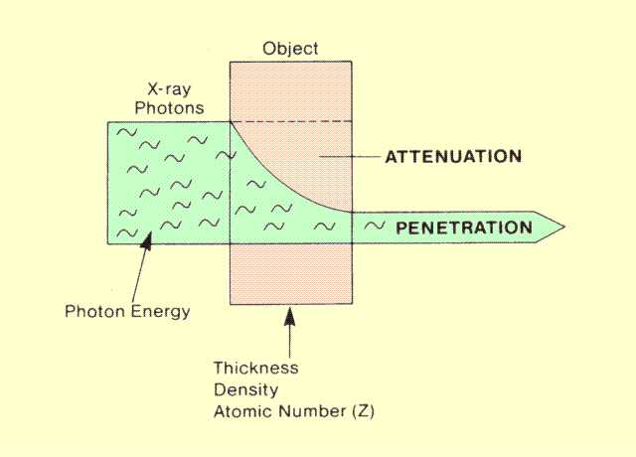
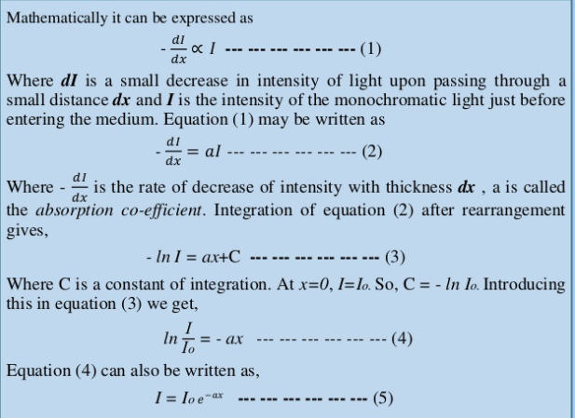
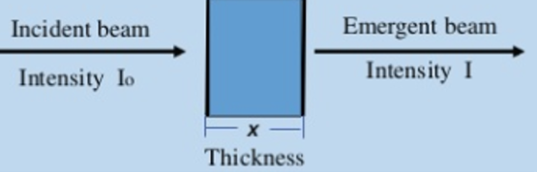
Beer’s Law (Monochromatic Light)
http://www.sprawls.org/ppmi2/RADPEN/
https://www.slideshare.net/MorshedulHaque/beer-lamberts-law

Slide 18
Mono- & Poly-Data Models
Spectrum
Energy

Slide 19
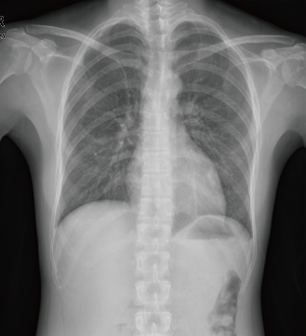
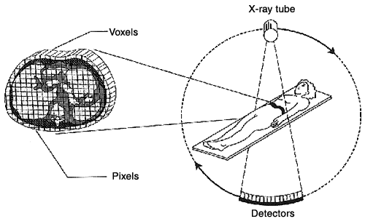
Beer’s Law to Linear Equation

Slide 20
Outline
X-ray Nature
Wave
Particle
X-ray Attenuation
Mechanisms
Beer’s Law
X-ray Tubes/Sources & Detectors
Sources & Detectors
Breast Imaging Examples
Radiation Dose
Dosimetry
Low-dose CT

Slide 21
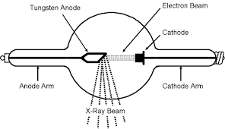
X-ray Tube: Simple View
kVp
http://www.dmlp.org/legal-guide/fair-use

Slide 22
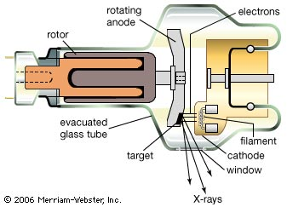
X-ray Tube: Pretty View
kVp

Slide 23
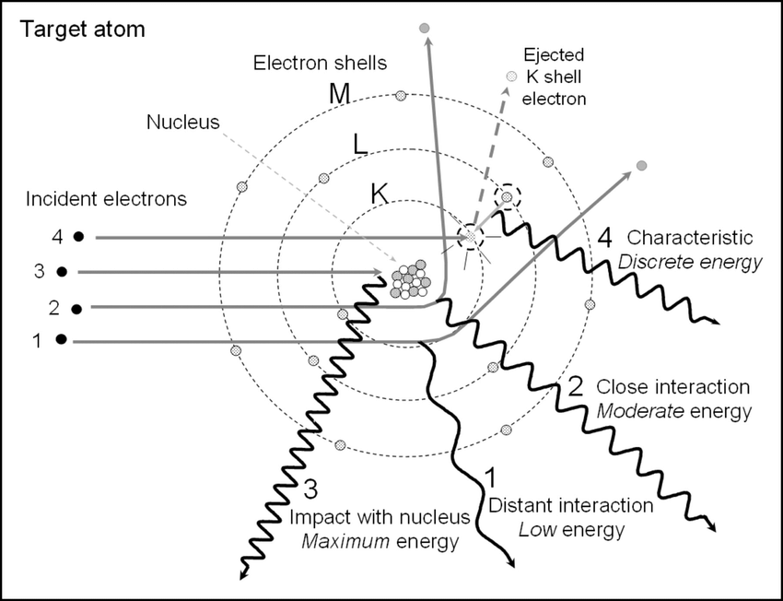
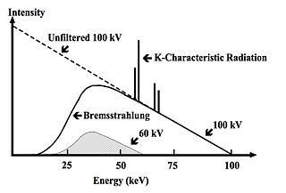
X-ray Spectrum
AU - Roque, Rita
PY - 2018/06/13
T1 - X-ray imaging using 100 μm thick Gas Electron Multipliers operating in Kr-CO2 mixtures
DO - 10.13140/RG.2.2.16794.49600
kVp

Slide 24
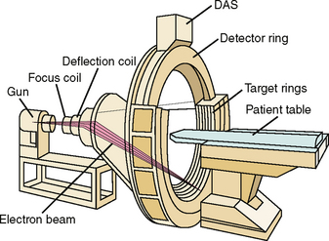
E-beam Scanner

Slide 25
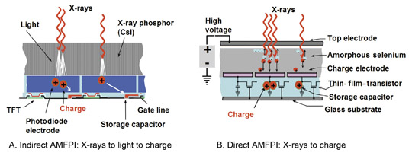
Energy-integrating Detector

Slide 26
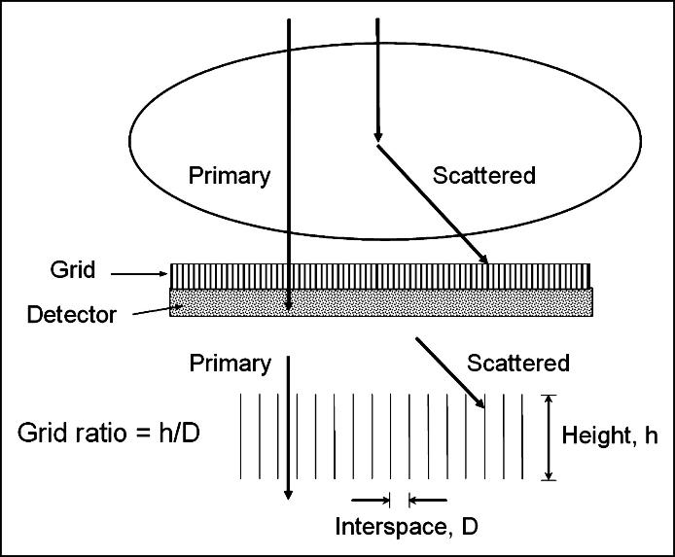
Anti-scatter Grid
With Grid
Without Grid

Slide 27
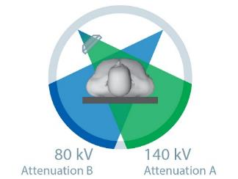
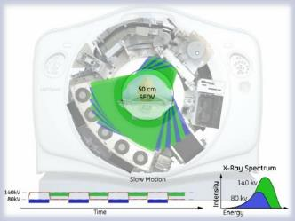
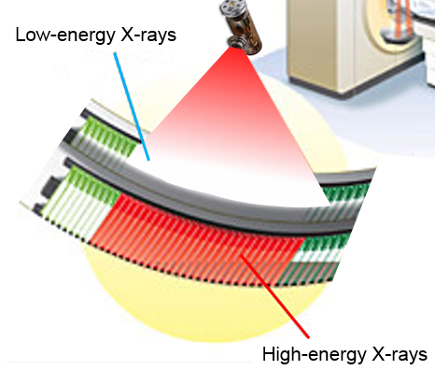
Dual-energy CT Technologies
Dual-Source
Dual-kVp
Dual-Layer

Slide 28
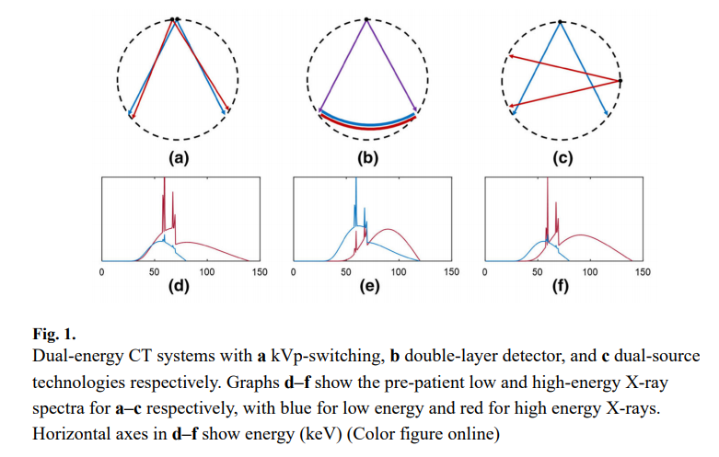
Dual-energy Measurements
https://www.ncbi.nlm.nih.gov/pmc/articles/PMC5761343/

Slide 29
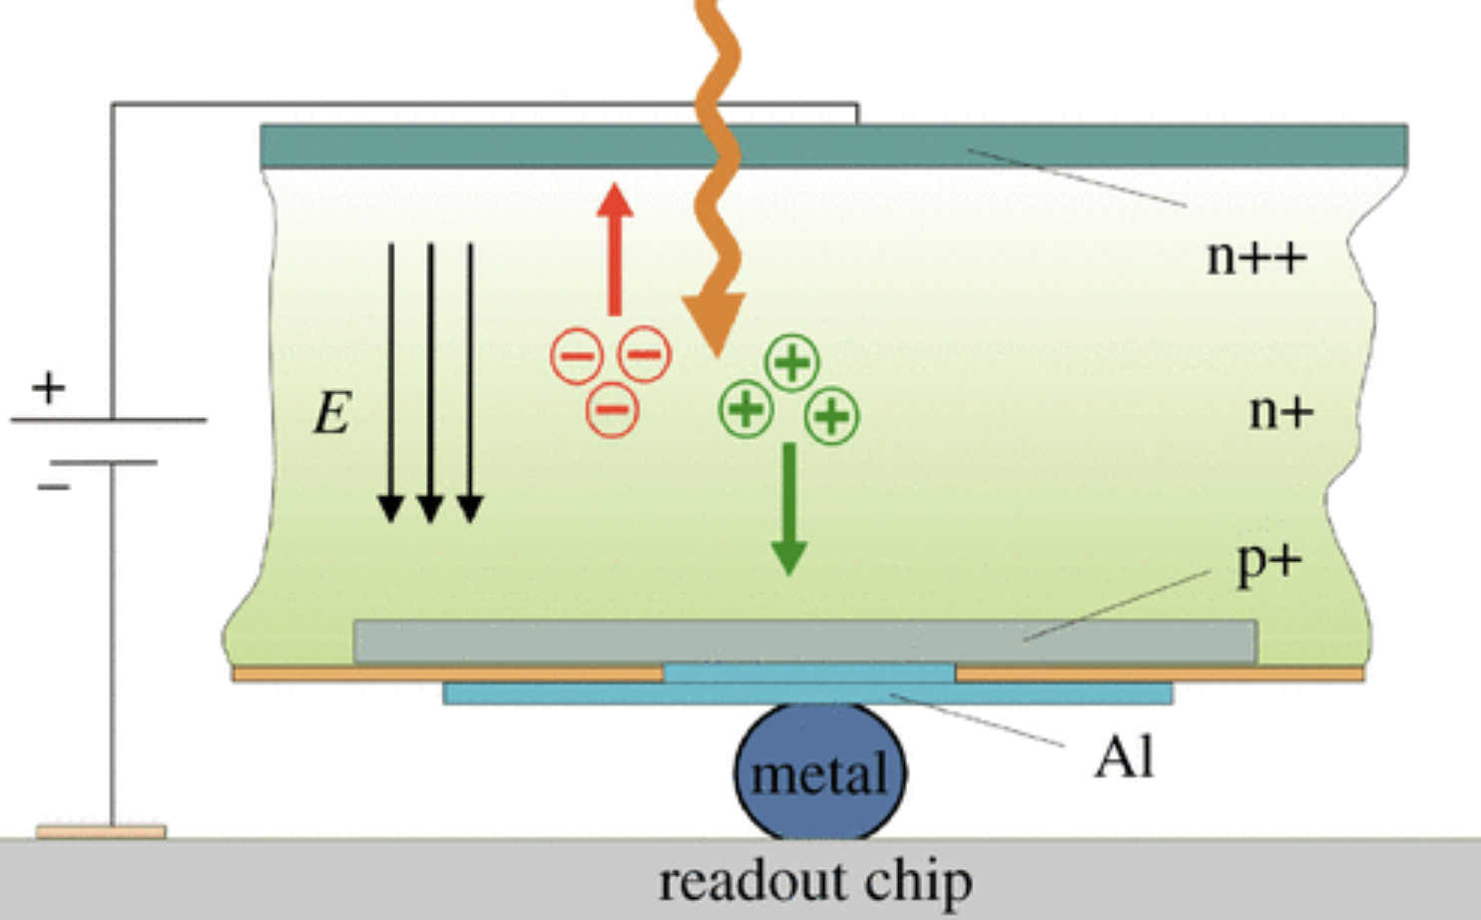
Photon-counting Detector

Slide 30
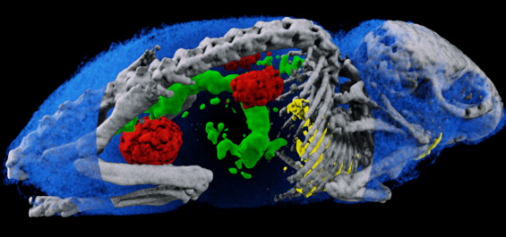

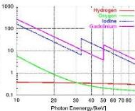

Toward Spectral CT
X-ray Source
Single Spectrum CT
B/W
Grey-scale
detector
Hounsfield Units
Patient
X-ray Source
B/W
Dual Energy
CT
X-ray Source
B/W
Two Grey-scale
Detectors
MARS
Spectral CT
X-ray Source
Medipix
Color
Detectors
Permission by Anthony Butler

Slide 31
Outline
X-ray Nature
Wave
Particle
X-ray Attenuation
Mechanisms
Beer’s Law
X-ray Tubes/Sources & Detectors
Sources & Detectors
Breast Imaging Examples
Radiation Dose
Dosimetry
Low-dose CT

Slide 32
Ionizing Radiation Effects
Ionizing: Free Electrons in Biological Tissue
Stochastic Risks
Cell Injury/Death
Cell Modification toward Malignancy or Genetic Damage
Deterministic Damages
Complete Tissue Damage above a Threshold
Severe Tissue Reaction
Potential Benefits??
Evolutionary?
Dropout Effect?

Slide 33
Equivalent Dose (Radiation Normalized)
Absorbed Dose D [Gray (Gy)]
1 Gy = 1 J/kg
Cataract Risk per 5 Gy: 100%
Equivalent Dose H_{T} in Tissue t [Sievert (Sv)]
H_{t} = Σ_{r} c_{r}D_{t,r}
D_{t,r}: Absorbed Radiation of Type r in Tissue of Type t
c_{r} : Weighting Radiation (1 for X-ray, 20 for α Particles)
1 Sv = 1 Gy * 1 (for X-ray, Others Made Equivalent to X-ray)
Lung Cancer Risk per Sv: 1.14%

Slide 34
Effective Dose (Radiation & Tissue Normalized)
Effective Dose E: Overall Detriment [in Sievert (Sv)]
E = Σ_{t}d_{t}H_{t}
d_{t} : Weighting Tissue
Lung, Breast: 0.12
Gonads: 0.08
Bladder, Liver: 0.04
Brain, Skin: 0.01

Slide 35
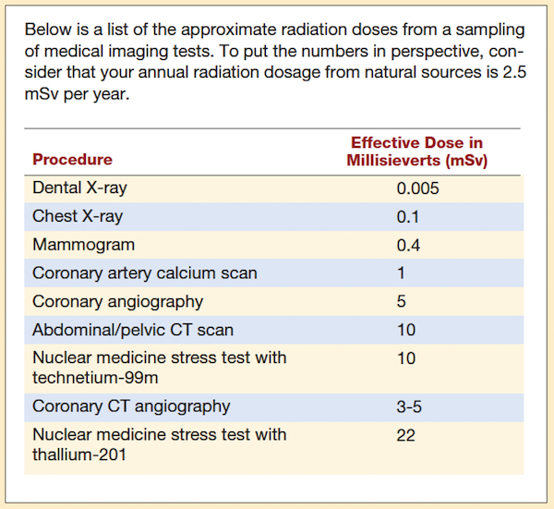
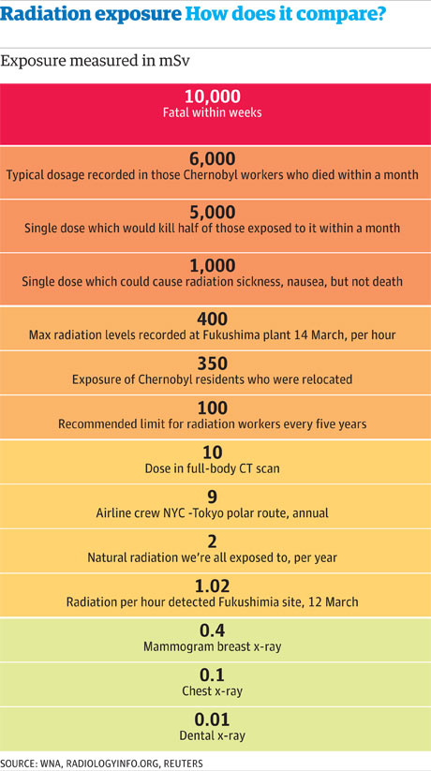
Effective Doses for Typical Imaging Exams
https://www.grepmed.com/images/1829/patientinfo-procedures-comparison-radiology-chestxray-radiation-imaging

Slide 36
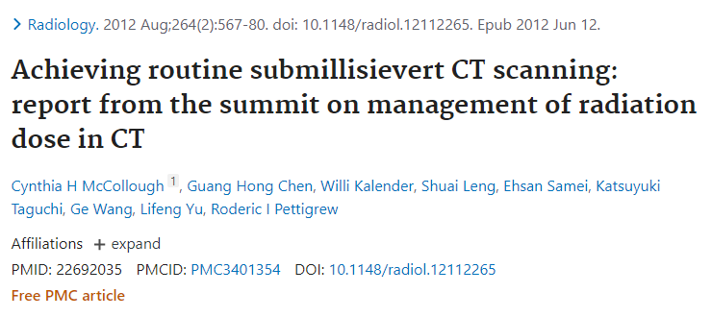
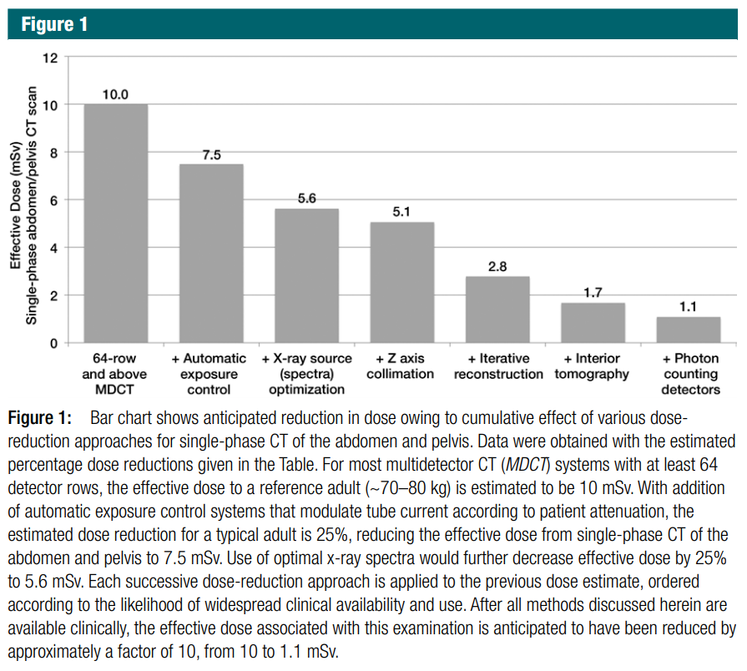
Low-dose CT

Slide 37
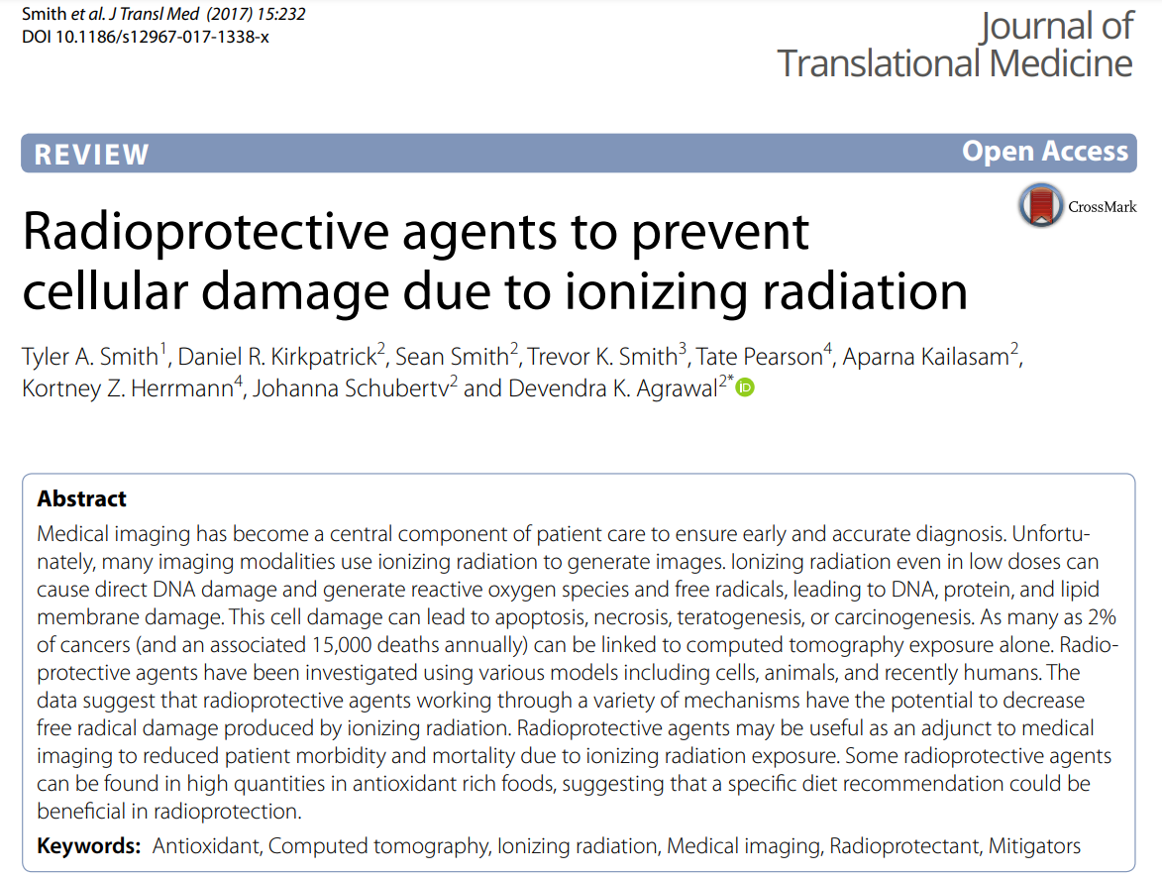
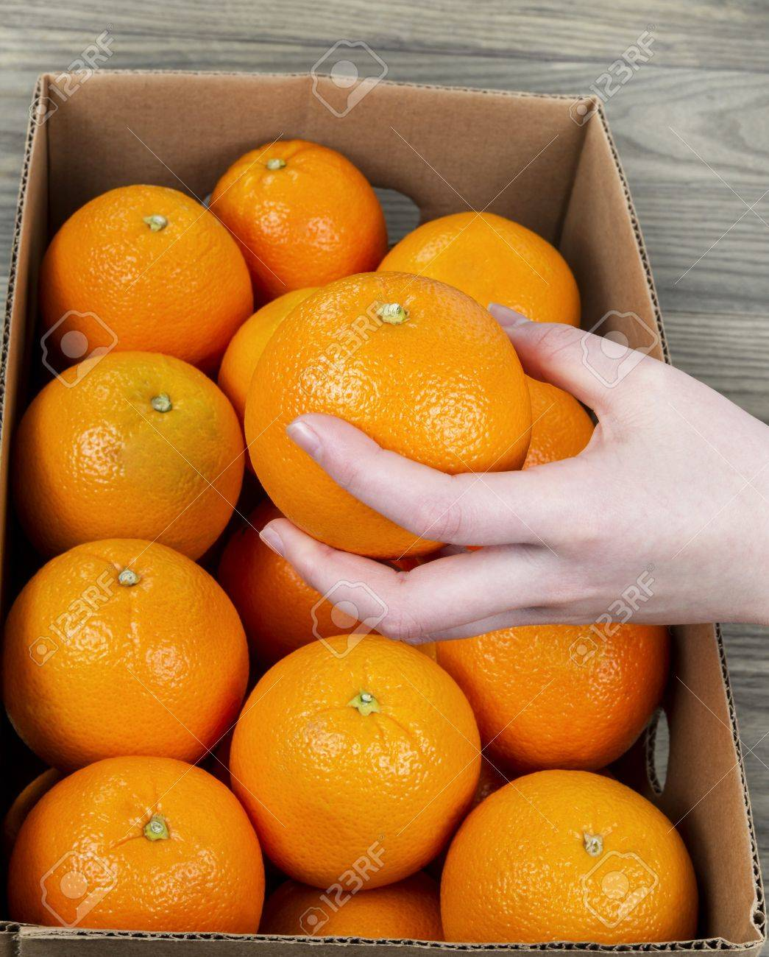
Out of Box Solution

Slide 38
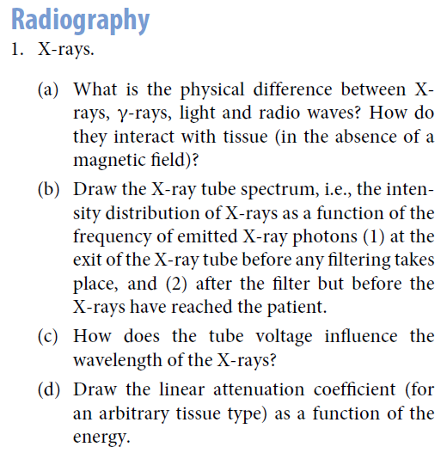
Homework
Please discuss if we only take one x-ray radiograph of an object (say a breast), should we compress the object or not for better screening or diagnosis?

